Slide 1
SELF BALANCING 1AXIS DRONE

Slide 2
TABLE OF CONTENTS
01
02
03
PLANNING
OUR PROCESS
PAST FAILURES

Slide 3
PLANNING
-getting an overall idea
-brainstorming
-can we do it?

Slide 4
UNDERSTANDING THE PROBLEM
TIME
MONEY
HOW TO?
LEARNING

Slide 5
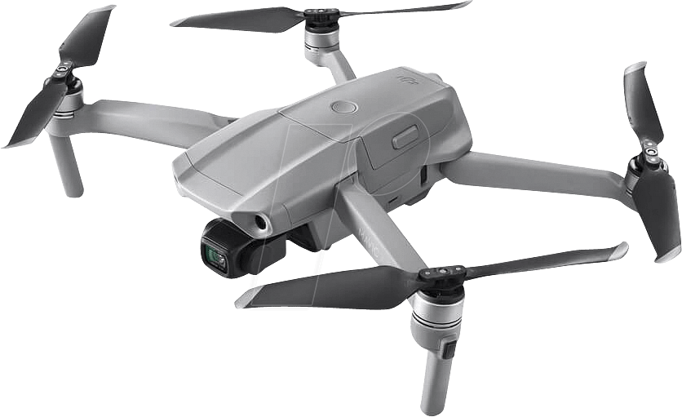
SIMPLYFYING
===>

Slide 6
PLANNING
01

Slide 7

PLANNING
DATA COLLECTION & FILTERING WITH BUTTERWORTH
FORMULA:
$$H\left(s\right)=\frac{1}{1+{\left(\frac{s}{ω_{c}}\right)}^{2N}}$$

Slide 8
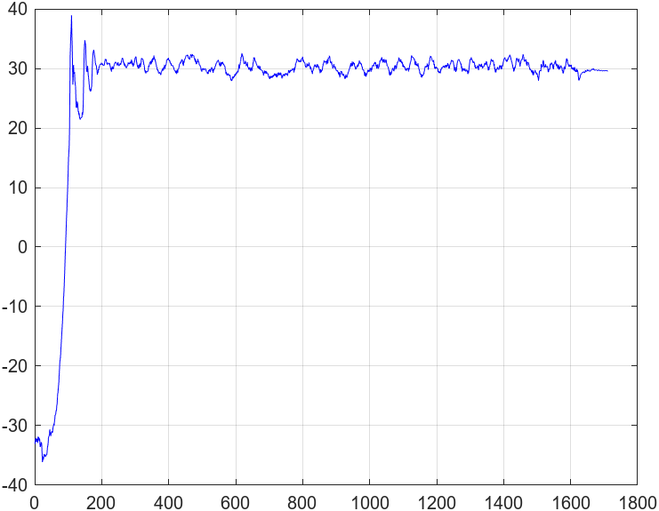
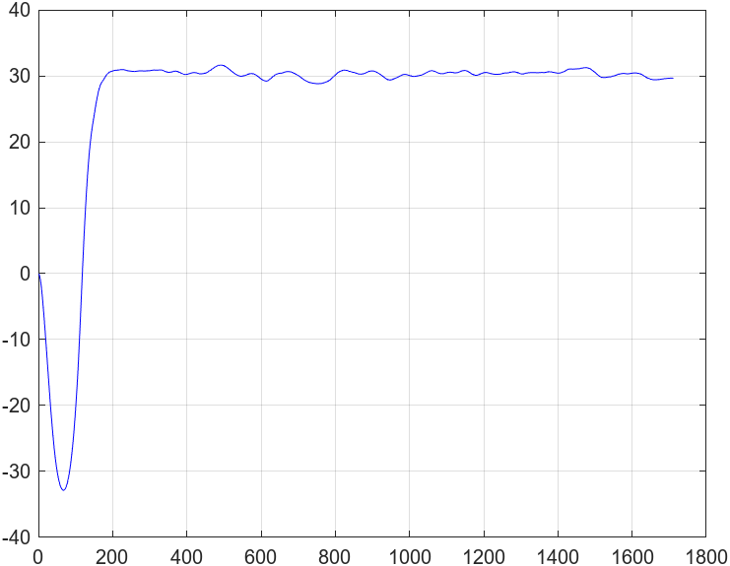
MOTOR 1
===>

Slide 9
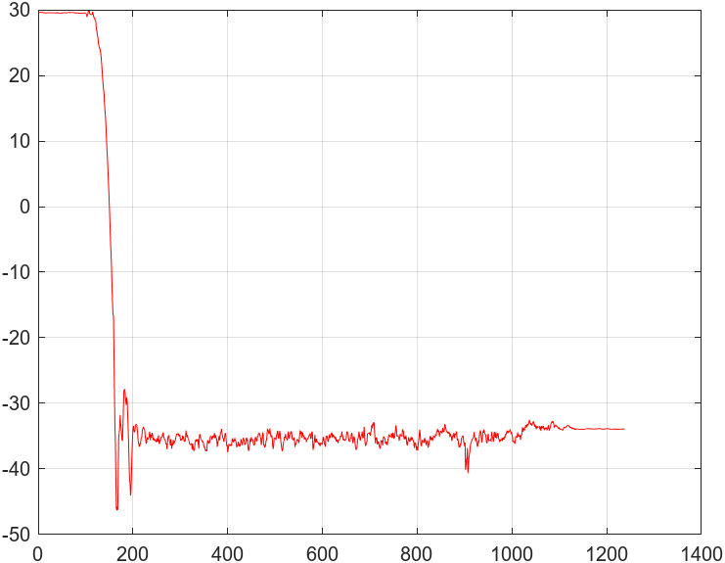
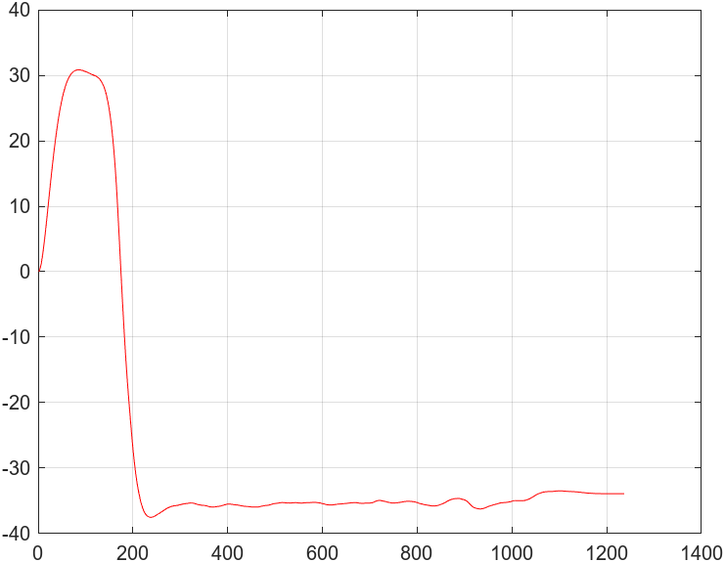
MOTOR 2
===>

Slide 10
OUR PROCESS
02

Slide 11
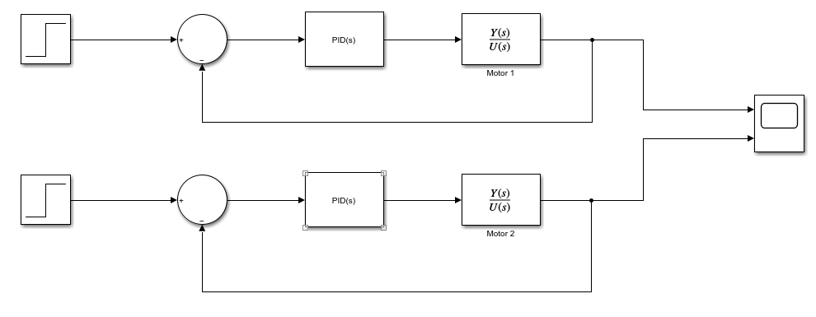

OUR PROCESS
PIDT1 CONTROLLER & CONTROL SYSTEM
FORMULA:
$$P\left(1+I\frac{1}{s}+D\frac{N}{1+N\frac{1}{s}}\right)$$

Slide 12
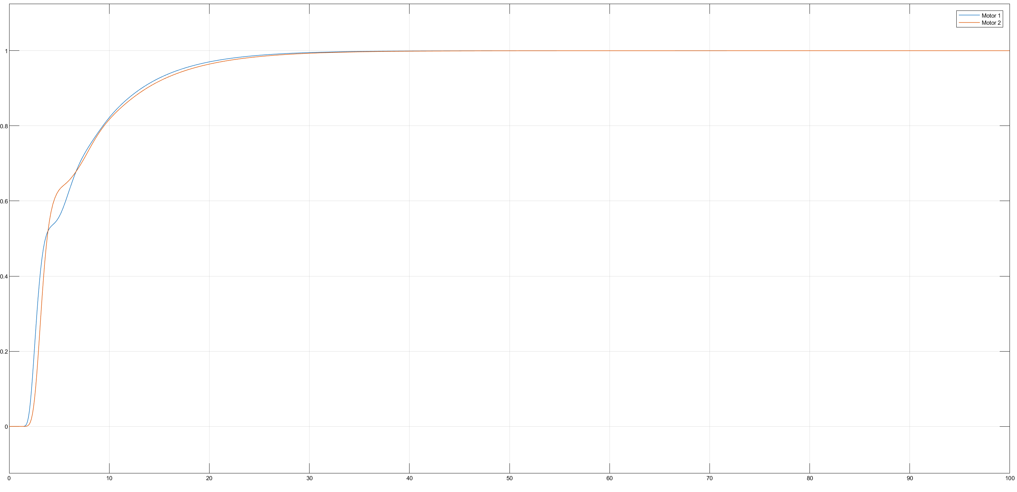

Slide 13
ARDUINO CODE
IMU
ARDUINO
MOTORS

Slide 14

PARAMETERS OF THE DIFFERENCE EQUATION
//MOTOR1
float upp1[3] = { 0.037556772508577, 0.030728268395416, 0};
float ypp1[3] = { 1, -1, 0};
//MOTOR2
float upp2[3] = { -13.100701652605988, 13.043720316359739, 0};
float ypp2[3] = { 1, -1, 0};
FORMULA FOR FIRST-ORDER HOLDER(FoH)
$$s=\frac{1−{\left(z\right)}^{−1}}{z^{−1}T_{e}}$$

Slide 15
float controller(float pos, float target_pos, int esc_pin, float &ups, float &upt, float &yps, float &ypt, float upp[], float ypp[]) { //filtrare float pos_actual = filter(smooth(pos)); //unghiul actual al ansamblului //PID float up = target_pos - pos_actual; if(up < 3 && up > -3) up = 0; float utp = upp[0] * up + upp[1] * ups + upp[2] * upt; float ytp = -yps * ypp[1] - ypt * ypp[2]; //for not stacking too much if(ytp < -500) ytp = -500; if(ytp > 500) ytp = 500; float yp = utp + ytp; // and errors upt = ups; ups = up; ypt = yps; yps = yp; return yp; }

Slide 16
PAST FAILURES
03

Slide 17
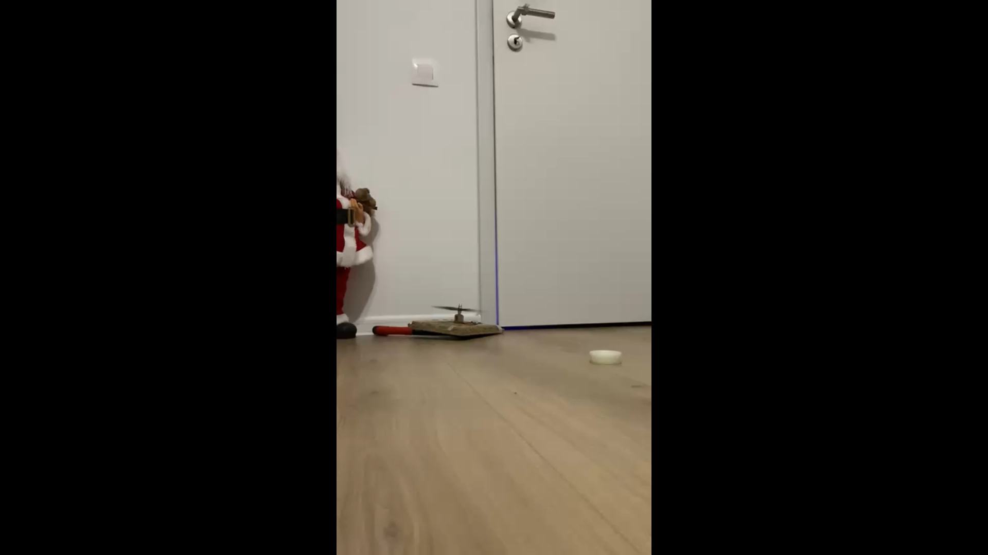

Slide 18
THANKS Obama

